Slide 1




Portfolio using HTML, CSS and Javascript
Outline
Introduction
Overview
Motivation
Data Flow Diagram

Slide 2

Portfolio using HTML, CSS and Javascript
Outline
Introduction
Data Flow Diagram
Methods
Summary
Bibliography
Introduction
Overview
Motivation
Data Flow Diagram

Slide 3
Portfolio using HTML, CSS and Javascript
Outline
Introduction
Overview
HTML provides the basic structure of sites, which is enhanced and modified by other technologies like CSS and Javascript.
CSS is used to control presentation, formatting, and layout.
Javascript is used to control the behaviour of different elements.
Motivation
Motivation for creating a portfolio
Importance of having an online presence
Benefits of showcasing your work
Data Flow Diagram

Slide 4


Portfolio using HTML, CSS and Javascript
Outline
Introduction
Overview
Motivation
Data Flow Diagram
Existing User
New User
Username
&
Password
Invalid
Details
Submit Details
User Process
Validate Details
Member Database
Validated
Details
Details
User
Launch Pad
Methods
Summary
Bibliography

Slide 5

Portfolio using HTML, CSS and Javascript
Outline
Introduction
Overview
Motivation
Data Flow Diagram
Methods
Summary
Bibliography

Slide 6
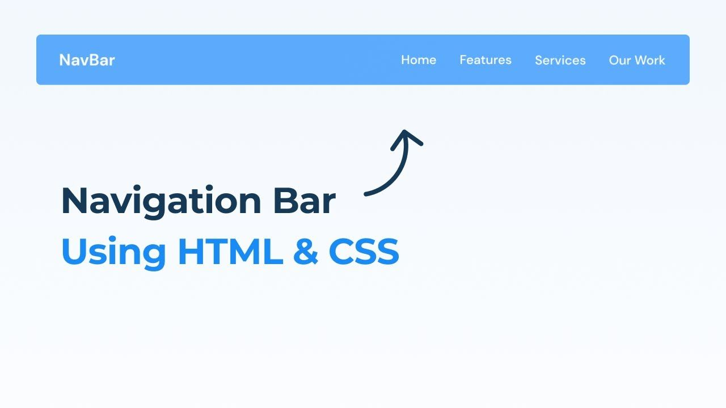

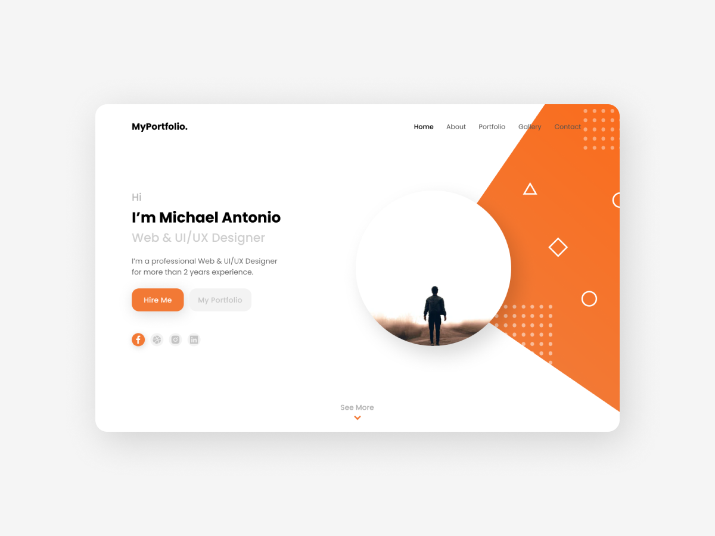
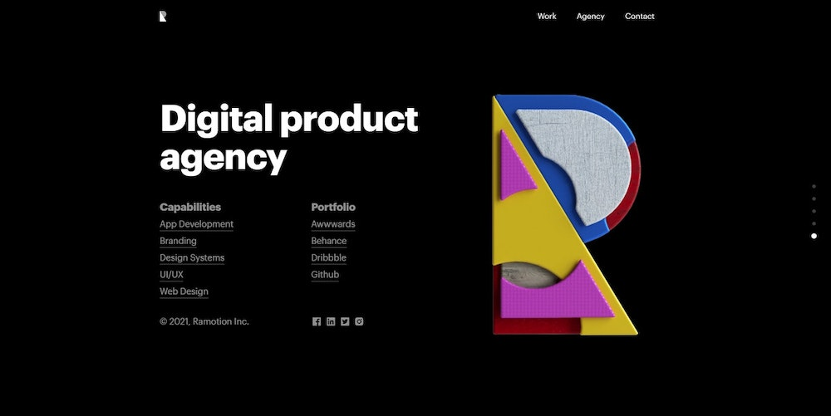


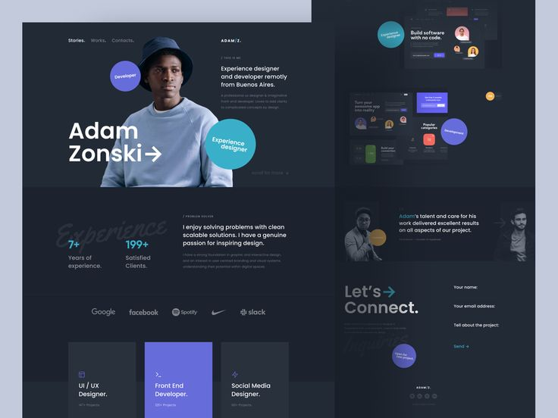

Portfolio using HTML, CSS and Javascript
Outline
Introduction
Overview
Motivation
Data Flow Diagram
Methods
ABOUT ME
HERO SECTION
Summary
In this section, you can get creative. This can help you to to stand out.
Step Five: Add Work Experience section
FOOTER
HTML
The navigation bar is a short representation of the content on the website.
CONTACT US
WORK/ EXPERIENCE
The footer can be experienced as a minor section, but it is an important one of every website.
Type an HTML skeleton code, which is the starting point for your website. It is the structure which holds the code and ensures that it is properly displayed on the internet.
The Hero section, together with the navigation bar, is the first section of your portfolio that people will see.
The work experience section highlights the experience, knowledge, and competence that you have made along your way.
NAVIGATION BAR
ABOUT ME
HERO SECTION
FOOTER
In this section, you can get creative. This can help you to to stand out.
Step Five: Add Work Experience section
FOOTER
HTML
HTML
The navigation bar is a short representation of the content on the website.
CONTACT US
The footer can be experienced as a minor section, but it is an important one of every website.
WORK/ EXPERIENCE
The footer can be experienced as a minor section, but it is an important one of every website.
Type an HTML skeleton code, which is the starting point for your website. It is the structure which holds the code and ensures that it is properly displayed on the internet.
Type an HTML skeleton code, which is the starting point for your website. It is the structure which holds the code and ensures that it is properly displayed on the internet.
The Hero section, together with the navigation bar, is the first section of your portfolio that people will see.
The contact section is the section that lets your visitor get in touch with you.
The work experience section highlights the experience, knowledge, and competence that you have made along your way.

Slide 7
Portfolio using HTML, CSS and Javascript
Outline
Introduction
Overview
Motivation
Data Flow Diagram
Methods
ABOUT ME
HERO SECTION
Summary
In this section, you can get creative. This can help you to to stand out.
Step Five: Add Work Experience section
FOOTER
HTML
The navigation bar is a short representation of the content on the website.
CONTACT US
WORK/ EXPERIENCE
The footer can be experienced as a minor section, but it is an important one of every website.
Type an HTML skeleton code, which is the starting point for your website. It is the structure which holds the code and ensures that it is properly displayed on the internet.
The Hero section, together with the navigation bar, is the first section of your portfolio that people will see.
The work experience section highlights the experience, knowledge, and competence that you have made along your way.
NAVIGATION BAR
ABOUT ME
HERO SECTION
FOOTER
In this section, you can get creative. This can help you to to stand out.
Step Five: Add Work Experience section
FOOTER
HTML
HTML
The navigation bar is a short representation of the content on the website.
CONTACT US
The footer can be experienced as a minor section, but it is an important one of every website.
WORK/ EXPERIENCE
The footer can be experienced as a minor section, but it is an important one of every website.
Type an HTML skeleton code, which is the starting point for your website. It is the structure which holds the code and ensures that it is properly displayed on the internet.
Type an HTML skeleton code, which is the starting point for your website. It is the structure which holds the code and ensures that it is properly displayed on the internet.
The Hero section, together with the navigation bar, is the first section of your portfolio that people will see.
The contact section is the section that lets your visitor get in touch with you.
The work experience section highlights the experience, knowledge, and competence that you have made along your way.

Slide 8
Portfolio using HTML, CSS and Javascript
Outline
Introduction
Overview
Motivation
Data Flow Diagram
Methods
ABOUT ME
HERO SECTION
Summary
In this section, you can get creative. This can help you to to stand out.
Step Five: Add Work Experience section
FOOTER
HTML
The navigation bar is a short representation of the content on the website.
CONTACT US
WORK/ EXPERIENCE
The footer can be experienced as a minor section, but it is an important one of every website.
Type an HTML skeleton code, which is the starting point for your website. It is the structure which holds the code and ensures that it is properly displayed on the internet.
The Hero section, together with the navigation bar, is the first section of your portfolio that people will see.
The work experience section highlights the experience, knowledge, and competence that you have made along your way.
NAVIGATION BAR
ABOUT ME
NAVIGATION BAR
HERO SECTION
HERO SECTION
FOOTER
In this section, you can get creative. This can help you to to stand out.
Step Five: Add Work Experience section
FOOTER
HTML
HTML
The navigation bar is a short representation of the content on the website.
CONTACT US
The navigation bar is a short representation of the content on the website.
The footer can be experienced as a minor section, but it is an important one of every website.
WORK/ EXPERIENCE
The footer can be experienced as a minor section, but it is an important one of every website.
Type an HTML skeleton code, which is the starting point for your website. It is the structure which holds the code and ensures that it is properly displayed on the internet.
The Hero section, together with the navigation bar, is the first section of your portfolio that people will see.
Type an HTML skeleton code, which is the starting point for your website. It is the structure which holds the code and ensures that it is properly displayed on the internet.
The Hero section, together with the navigation bar, is the first section of your portfolio that people will see.
The contact section is the section that lets your visitor get in touch with you.
The work experience section highlights the experience, knowledge, and competence that you have made along your way.
The work experience section highlights the experience, knowledge, and competence that you have made along your way.

Slide 9
Portfolio using HTML, CSS and Javascript
Outline
Introduction
Overview
Motivation
Data Flow Diagram
Methods
ABOUT ME
HERO SECTION
Summary
In this section, you can get creative. This can help you to to stand out.
Step Five: Add Work Experience section
FOOTER
HTML
The navigation bar is a short representation of the content on the website.
CONTACT US
WORK/ EXPERIENCE
The footer can be experienced as a minor section, but it is an important one of every website.
Type an HTML skeleton code, which is the starting point for your website. It is the structure which holds the code and ensures that it is properly displayed on the internet.
The Hero section, together with the navigation bar, is the first section of your portfolio that people will see.
The work experience section highlights the experience, knowledge, and competence that you have made along your way.
NAVIGATION BAR
ABOUT ME
NAVIGATION BAR
HERO SECTION
ABOUT ME
HERO SECTION
FOOTER
In this section, you can get creative. This can help you to to stand out.
Step Five: Add Work Experience section
FOOTER
HTML
HTML
In this section, you can get creative. This can help you to to stand out.
Step Five: Add Work Experience section
The navigation bar is a short representation of the content on the website.
CONTACT US
The navigation bar is a short representation of the content on the website.
CONTACT US
The footer can be experienced as a minor section, but it is an important one of every website.
WORK/ EXPERIENCE
The footer can be experienced as a minor section, but it is an important one of every website.
Type an HTML skeleton code, which is the starting point for your website. It is the structure which holds the code and ensures that it is properly displayed on the internet.
The Hero section, together with the navigation bar, is the first section of your portfolio that people will see.
Type an HTML skeleton code, which is the starting point for your website. It is the structure which holds the code and ensures that it is properly displayed on the internet.
The Hero section, together with the navigation bar, is the first section of your portfolio that people will see.
The contact section is the section that lets your visitor get in touch with you.
The work experience section highlights the experience, knowledge, and competence that you have made along your way.
The work experience section highlights the experience, knowledge, and competence that you have made along your way.

Slide 10
Portfolio using HTML, CSS and Javascript
Outline
Introduction
Overview
Motivation
Data Flow Diagram
Methods
ABOUT ME
HERO SECTION
Summary
In this section, you can get creative. This can help you to to stand out.
Step Five: Add Work Experience section
FOOTER
HTML
The navigation bar is a short representation of the content on the website.
CONTACT US
WORK/ EXPERIENCE
The footer can be experienced as a minor section, but it is an important one of every website.
Type an HTML skeleton code, which is the starting point for your website. It is the structure which holds the code and ensures that it is properly displayed on the internet.
The Hero section, together with the navigation bar, is the first section of your portfolio that people will see.
The work experience section highlights the experience, knowledge, and competence that you have made along your way.
NAVIGATION BAR
ABOUT ME
NAVIGATION BAR
HERO SECTION
ABOUT ME
HERO SECTION
FOOTER
In this section, you can get creative. This can help you to to stand out.
Step Five: Add Work Experience section
FOOTER
FOOTER
HTML
HTML
In this section, you can get creative. This can help you to to stand out.
Step Five: Add Work Experience section
The navigation bar is a short representation of the content on the website.
CONTACT US
The navigation bar is a short representation of the content on the website.
CONTACT US
The footer can be experienced as a minor section, but it is an important one of every website.
WORK/ EXPERIENCE
The footer can be experienced as a minor section, but it is an important one of every website.
The footer can be experienced as a minor section, but it is an important one of every website.
Type an HTML skeleton code, which is the starting point for your website. It is the structure which holds the code and ensures that it is properly displayed on the internet.
The Hero section, together with the navigation bar, is the first section of your portfolio that people will see.
Type an HTML skeleton code, which is the starting point for your website. It is the structure which holds the code and ensures that it is properly displayed on the internet.
The Hero section, together with the navigation bar, is the first section of your portfolio that people will see.
The contact section is the section that lets your visitor get in touch with you.
The work experience section highlights the experience, knowledge, and competence that you have made along your way.
The work experience section highlights the experience, knowledge, and competence that you have made along your way.

Slide 11
Portfolio using HTML, CSS and Javascript
Outline
Introduction
Overview
Motivation
Data Flow Diagram
Methods
ABOUT ME
HERO SECTION
Summary
In this section, you can get creative. This can help you to to stand out.
Step Five: Add Work Experience section
FOOTER
HTML
The navigation bar is a short representation of the content on the website.
CONTACT US
WORK/ EXPERIENCE
The footer can be experienced as a minor section, but it is an important one of every website.
Type an HTML skeleton code, which is the starting point for your website. It is the structure which holds the code and ensures that it is properly displayed on the internet.
The Hero section, together with the navigation bar, is the first section of your portfolio that people will see.
The work experience section highlights the experience, knowledge, and competence that you have made along your way.
NAVIGATION BAR
ABOUT ME
NAVIGATION BAR
HERO SECTION
ABOUT ME
HERO SECTION
FOOTER
In this section, you can get creative. This can help you to to stand out.
Step Five: Add Work Experience section
FOOTER
FOOTER
HTML
HTML
In this section, you can get creative. This can help you to to stand out.
Step Five: Add Work Experience section
The navigation bar is a short representation of the content on the website.
CONTACT US
The navigation bar is a short representation of the content on the website.
CONTACT US
The footer can be experienced as a minor section, but it is an important one of every website.
WORK/ EXPERIENCE
The footer can be experienced as a minor section, but it is an important one of every website.
The footer can be experienced as a minor section, but it is an important one of every website.
Type an HTML skeleton code, which is the starting point for your website. It is the structure which holds the code and ensures that it is properly displayed on the internet.
The Hero section, together with the navigation bar, is the first section of your portfolio that people will see.
Type an HTML skeleton code, which is the starting point for your website. It is the structure which holds the code and ensures that it is properly displayed on the internet.
The Hero section, together with the navigation bar, is the first section of your portfolio that people will see.
The contact section is the section that lets your visitor get in touch with you.
The work experience section highlights the experience, knowledge, and competence that you have made along your way.
The work experience section highlights the experience, knowledge, and competence that you have made along your way.
The work experience section highlights the experience, knowledge, and competence that you have made along your way.

Slide 12
Portfolio using HTML, CSS and Javascript
Outline
Introduction
Overview
Motivation
Data Flow Diagram
Methods
Summary
Planning: Start by defining the purpose and goals of your portfolio. Determine the target audience and the type of content you want to include, such as your resume, projects, skills, and contact information.
HTML Structure: Begin by creating the basic structure of your portfolio using HTML. Use semantic elements to organize your content, such as headings, paragraphs, lists, and divs. Ensure your HTML is valid and accessible.
CSS Styling: Use CSS to apply styles to your portfolio and make it visually appealing. Define the layout, colors, typography, and spacing to create a cohesive and professional look. Consider using CSS frameworks like Bootstrap or Materialize for a faster development process.
Responsive Design: Make your portfolio responsive to ensure it looks good on various devices and screen sizes. Use media queries and responsive units like percentages or viewport units to adapt the layout and styling accordingly.
Navigation: Create a navigation menu to help users navigate through your portfolio. You can use an unordered list or a navigation bar, ensuring it is consistent across all pages. Implement smooth scrolling to enhance the user experience.
Project Showcase: Highlight your projects by creating dedicated sections or pages for each. Include project descriptions, images, links, and any relevant details. Consider using interactive elements or animations to make them engaging.
Skills and Achievements: Showcase your skills, certifications, and achievements using visually appealing elements. You can use icons, progress bars, or infographics to represent your proficiency levels or accomplishments.
Resume/CV: Include a downloadable version of your resume or CV in your portfolio. Provide a link or a button for users to access and save a PDF version of your document.
Contact Information: Make it easy for visitors to get in touch with you. Include your contact details, such as email address, phone number, and social media links. You can create a separate contact page or add a contact form for direct communication.
JavaScript Functionality: Enhance your portfolio with interactive features using JavaScript. Implement features like image sliders, form validation, modal windows, or dynamic content loading to make your portfolio more engaging and user-friendly.
Testing and Optimization: Test your portfolio across different browsers and devices to ensure it functions correctly and looks consistent. Optimize your code, images, and other assets for faster loading times.
Deployment: Choose a hosting provider and upload your portfolio to make it accessible on the web. Register a domain name that represents your personal brand if desired.
Bibliography

Slide 13
Portfolio using HTML, CSS and Javascript
Outline
Introduction
Overview
Motivation
Data Flow Diagram
Methods
Summary
Bibliography
1. MDN Web Docs (Mozilla Developer Network):
HTML: https://developer.mozilla.org/en-US/docs/Web/HTML
CSS: https://developer.mozilla.org/en-US/docs/Web/CSS
JavaScript: https://developer.mozilla.org/en-US/docs/Web/JavaScript
2. W3Schools:
HTML: https://www.w3schools.com/html/
CSS: https://www.w3schools.com/css/
JavaScript: https://www.w3schools.com/js/
3. GitHub (Version control and code repository):
Explore existing portfolios on GitHub to gain inspiration and learn from others. Search for "portfolio html css javascript" or similar keywords.

